Slide 1









@adbertram
@adbertram
Object-Oriented Function and Module Design
Presented by:
Adam the Automator

Slide 2

PS> Whoami
Pluralsight Author
PowerShell Trainer
Freelance Writer
PowerShell Consultant
Blog: adamtheautomator.com
Twitter: @adbertram
Microsoft Content/ Datacenter Management MVP

Slide 3

Who Is This For?
IT Professional/ Non-Developer
You know how modules, functions and parameters work
You care about good maintainable code
You are building a large project

Slide 4

I’m No Developer
I’m NOT a Developer
If you're a developer, I'm sorry
I'll use "devvy" concepts loosely A LOT
Meant to guide design decisions; not be a technical reference

Slide 5

Object-Oriented Programming (OOP)
An attempt to replicate the real world with code
Defining physical "things" in code
Managing those "things" with verbs in code

Slide 6

Applying OOP Principles to Module Design
Module = Object
Function = "Child" Object
Function Parameter = Property

Slide 7
The Hierarchy
Parent Module
Child Module
Function
Parameter

Slide 8
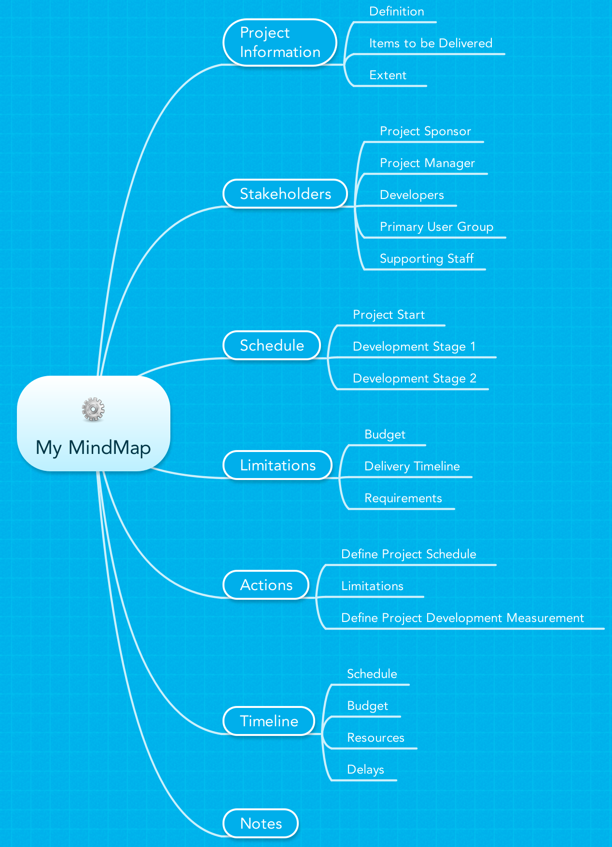
Planning
Mindmaps
Define your objects and how they'll interact
Define what object will "do"

Slide 9

Design
Create…Read…Update…Delete
Function or module?
Well-design modules use the pipeline (or can)
Limit function visibility
Powershell Land
Get-Object
New-Object
Remove-Object
Set-Object

Slide 10

Implementation Tips
Add PassThru to all Set functions
Standardize everything
Use parameters are exceptions

